Slide 1

WaveCon Telecom Analysis
Presented By: Tushar Gupta

Slide 2
Table of Content
Company Overview
Metrics That Matter
Important Reminders
Market Domination
Regional Insights
Plan Performance Review

Slide 3
Company Overview
WaveCon Telecom operates in major Indian cities, offering cutting-edge services and establishing a strong presence in key urban areas.
Our mission at WaveCon is to facilitate connections, empower businesses, and enhance lives through seamless communication solutions.
WaveCon serves prominent cities like Mumbai, Delhi, Kolkata, Bangalore, and others, ensuring widespread access to reliable telecom services.
Our dedication to innovation, customer satisfaction, and community engagement sets us apart in the competitive telecom industry landscape.
WaveCon Telecom is committed to expanding its reach and enhancing service quality, contributing to the advancement of telecommunications in India.

Slide 4
Important Reminders
WaveCon Telecom launched 5G services on June 1, 2022, expanding their offerings to cater to the evolving needs of users.
The company introduced a total of 13 plans tailored for both 4G and 5G users, ensuring a diverse range of options to meet customer preferences.
WaveCon Telecom currently provides services in approximately 15 cities across the country, facilitating connectivity for a wide user base.
During the presentation, abbreviations such as ARPU (Average Revenue Per User), TAU (Total Active Users), TUsU (Total Unsubscribed Users), and MA (Monthly Average) will be utilized for clarity and efficiency.

Slide 5
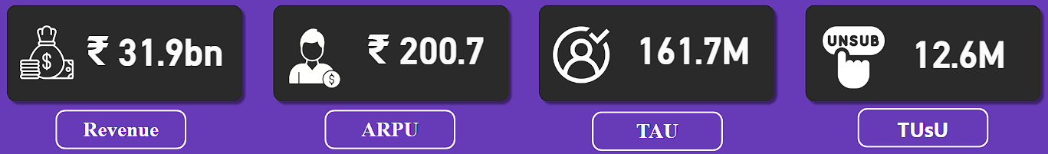
Metrics That Matters
WaveCon Telecom generated a revenue of 31.9 billion rupees.
Average Revenue Per User (ARPU) of 200.7 rupees.
The Total Active Users (TAU) amounted to 161.7 million.
Total Unsubscribed Users (TUsU) reached 12.6 million across various cities and months.

Slide 6
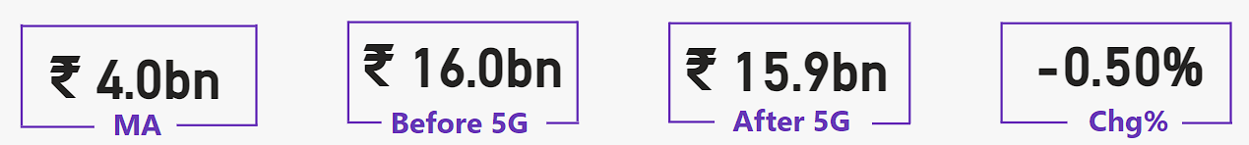
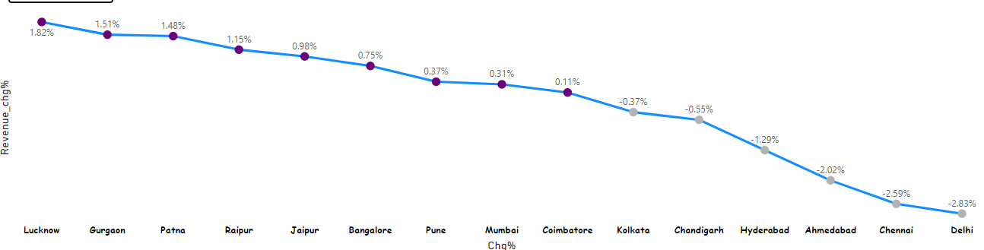
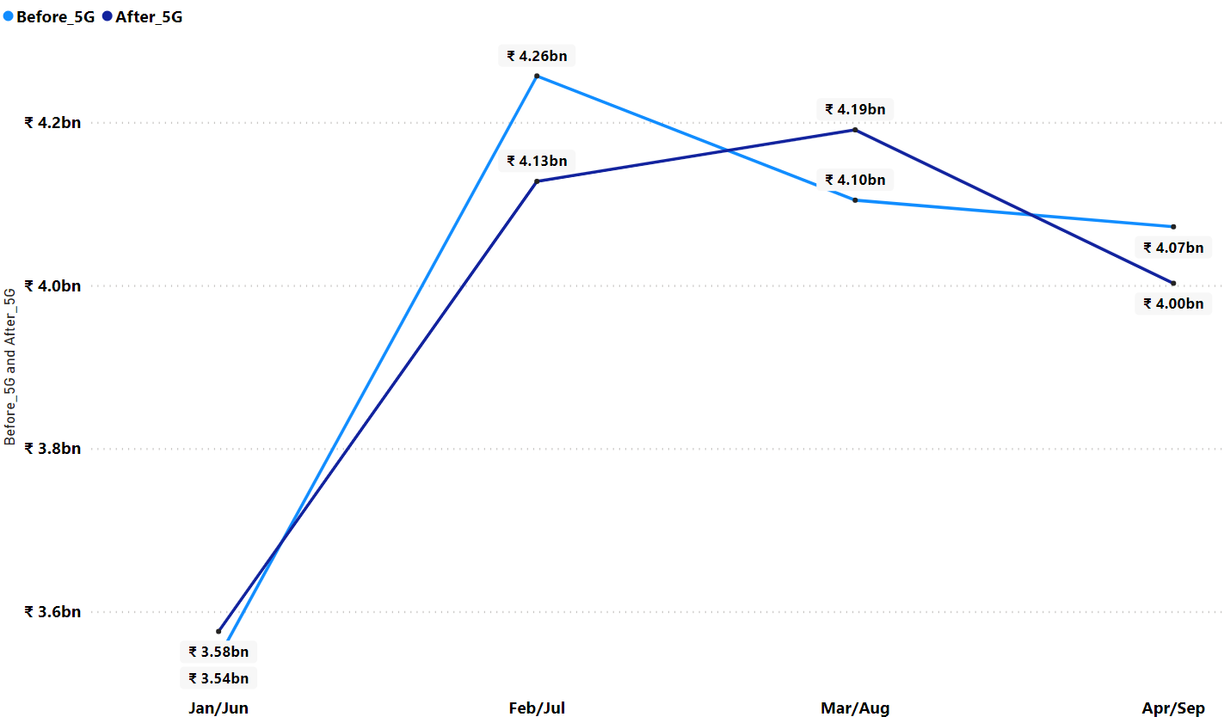
Revenue
In the first month post-5G launch, revenue increased from 3.54 billion to 3.58 billion, indicating a slight uptick in revenue following the implementation of 5G technology.
However, the second month saw a decrease in revenue from 4.26 billion to 4.13 billion after 5G rollout, suggesting a temporary decline in revenue metrics.
By the third month, revenue rebounded to 4.19 billion post-5G, showing a recovery from the previous month's decrease.
In the fourth month, revenue decreased slightly from 4.07 billion to 4.0 billion after 5G implementation, indicating fluctuations in revenue metrics post-5G rollout.
Lucknow and Gurgaon exhibit a revenue increase of over 1.5% following the launch of 5G services, highlighting positive growth in these cities post-implementation.
Conversely, Chennai and Delhi demonstrate a revenue loss exceeding 2.5% after the introduction of 5G, indicating challenges or setbacks in revenue generation in these areas following the technological transition.

Slide 7
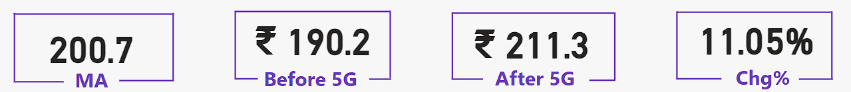
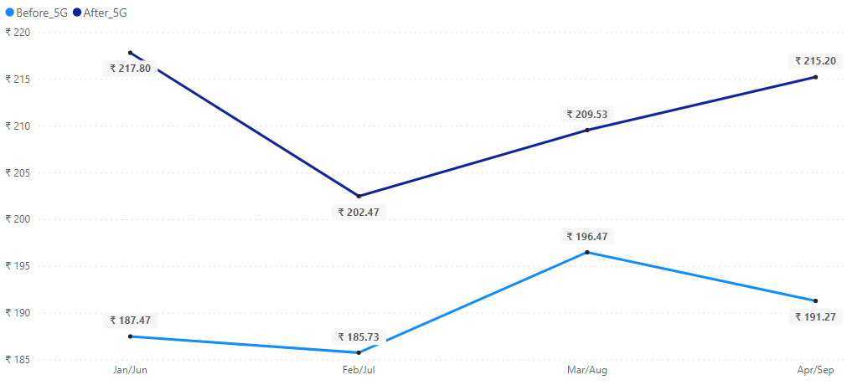
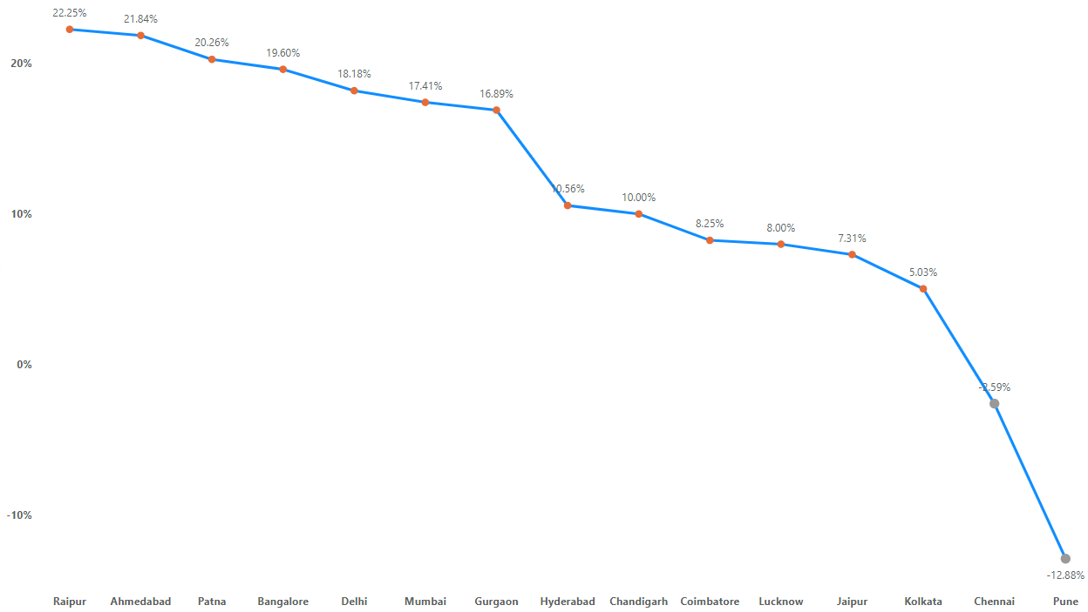
ARPU
June: ARPU surged to 217.80 rupees post-5G, indicating a significant increase from the pre-5G period.
July: ARPU declined to 202.47 rupees, reflecting potential challenges or fluctuations in user spending patterns.
August: ARPU slightly rebounded to 209.53 rupees, suggesting a potential stabilization in revenue metrics.
September: ARPU further increased to 215.20 rupees, indicating a potential recovery post-implementation of 5G.
Pre-5G period: ARPU started at 187 rupees in January, fluctuated slightly in February, gradually increased to 196 rupees in March, and slightly dropped to 191 rupees in April.
Raipur, Ahmedabad, and Patna demonstrate ARPU change percentages exceeding 20%, indicating substantial revenue increases post-5G implementation.
Conversely, Chennai and Pune exhibit negative ARPU change percentages of -2.59% and -12.88% respectively, suggesting a decline in revenue following the introduction of 5G technology.
Notes:
WaveCon's average revenue per unit is approximately 200 rupees per month. Before the launch of 5G, the average revenue per unit was about 190 rupees. After the launch of 5G, it increased to approximately 211 rupees, reflecting a change of 11.05%.
Post-5G ARPU Trends: ARPU surged to 217.80 rupees post-5G in June, then declined to 202.47 rupees in July, rebounded to 209.53 rupees in August, and increased to 215.20 rupees in September.
City-specific ARPU: Cities like Raipur, Ahmedabad, and Patna show ARPU increases exceeding 20%, while Chennai and Pune exhibit negative changes.

Slide 8
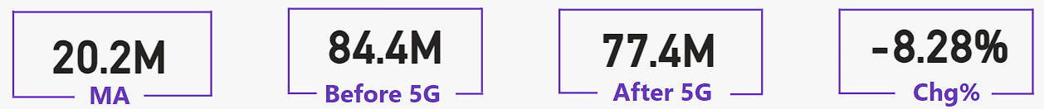
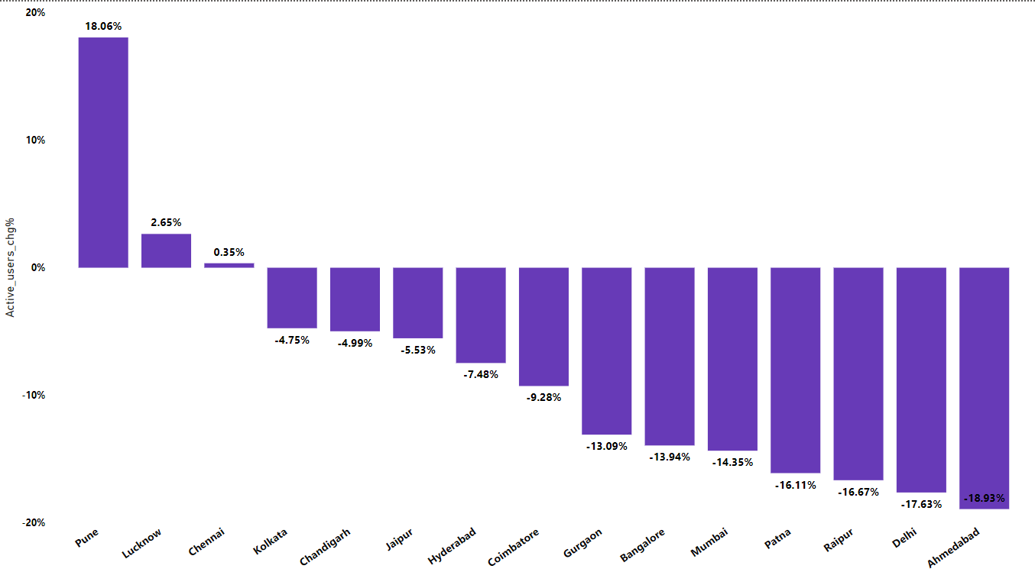
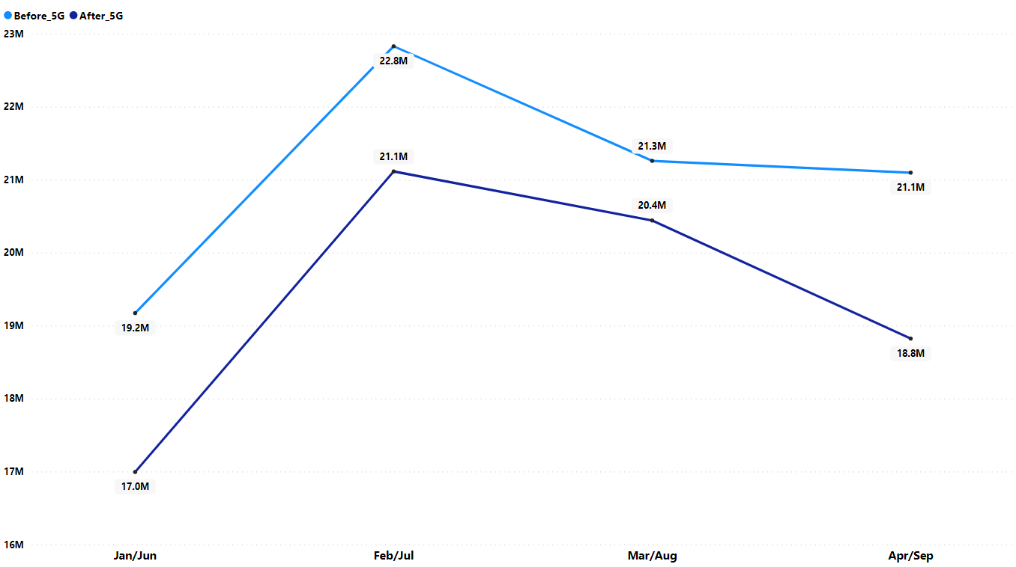
TAU
Positive trends in Active Users percentage were observed in Pune, Lucknow, and Chennai, indicating increases of 18.06%, 2.65%, and 0.35% respectively, post-5G implementation.
Conversely, the majority of cities experienced declines in Active Users, with Ahmedabad, Delhi, and Raipur showing the most significant decreases of -18.93%, -17.63%, and -16.67% respectively, following the transition to 5G services.
Month 1: Total active users decreased from 19.2 million to 17.0 million after 5G implementation, indicating an initial impact on user engagement.
Month 2: Active users temporarily rebounded from 22.8 million to 21.1 million post-5G, suggesting a short-term recovery.
Month 3: Total active users declined to 20.4 million after 5G, down from 21.3 million before, signaling a sustained downward trend.
Month 4: Active users continued to decrease, dropping to 18.8 million post-5G from 21.1 million before, highlighting ongoing challenges in user retention.

Slide 9
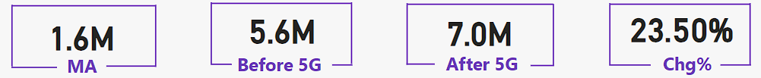
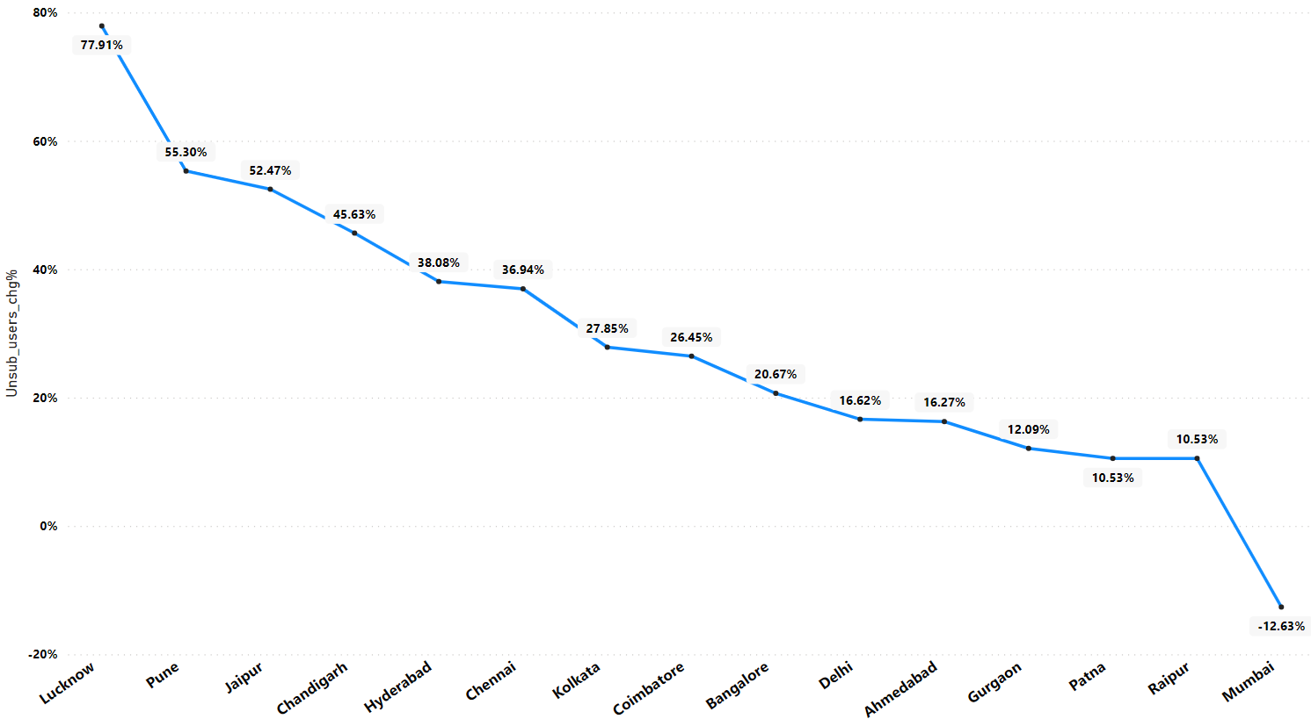
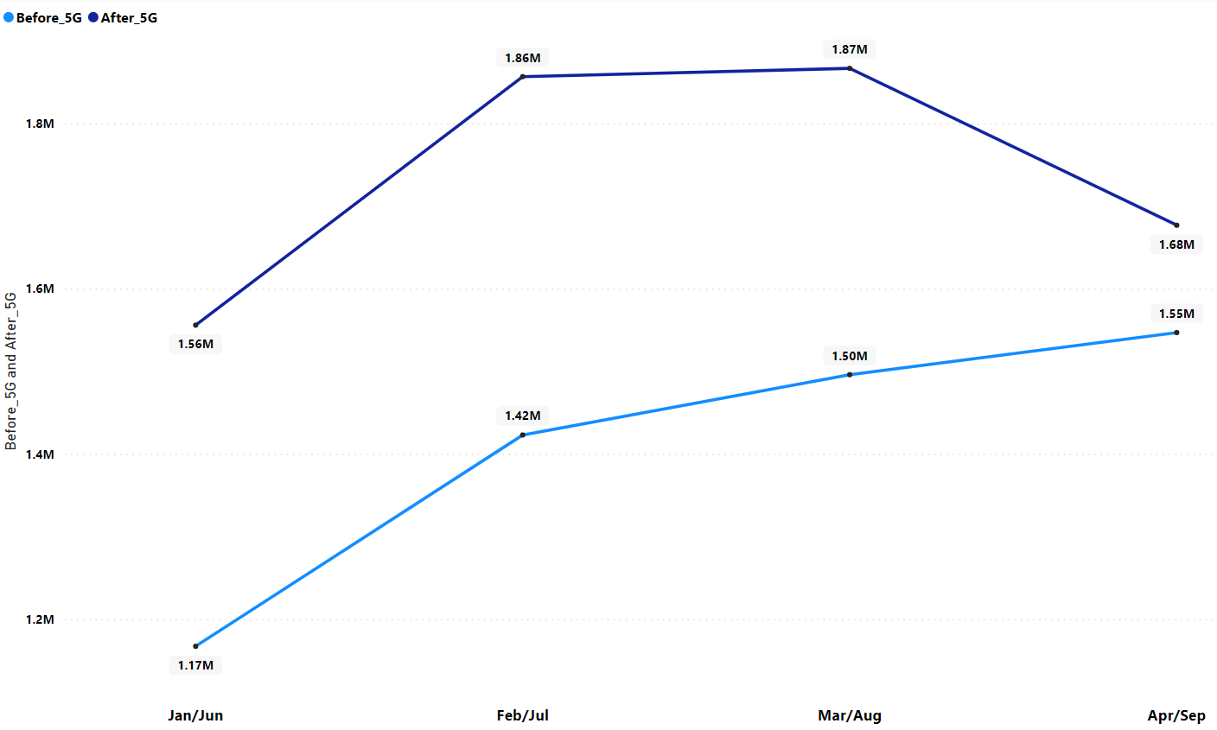
TuSU
Lucknow, Pune, and Jaipur exhibit the highest percentage change in unsubscribed users, with 77.91%, 55.3%, and 52.47% respectively, indicating a significant increase in user disengagement.
Conversely, Mumbai stands out with a negative change of -12.43%, suggesting a decrease in unsubscribed users, potentially reflecting higher user retention or satisfaction levels compared to other cities.
The monthly trend chart of percentage change in Total Unsubscribed Users (TUsU) indicates an increase in the first month after the introduction of 5G, with 1.56 million compared to 1.17 million before 5G.
This trend continues in the second month, with TUsU rising to 1.86 million from 1.42 million before 5G.
In the third month, TUsU remains elevated at 1.87 million, up from 1.50 million before 5G.
However, there is a slight decrease in TUsU in the fourth month, with 1.68 million after 5G compared to 1.55 million before 5G.

Slide 10
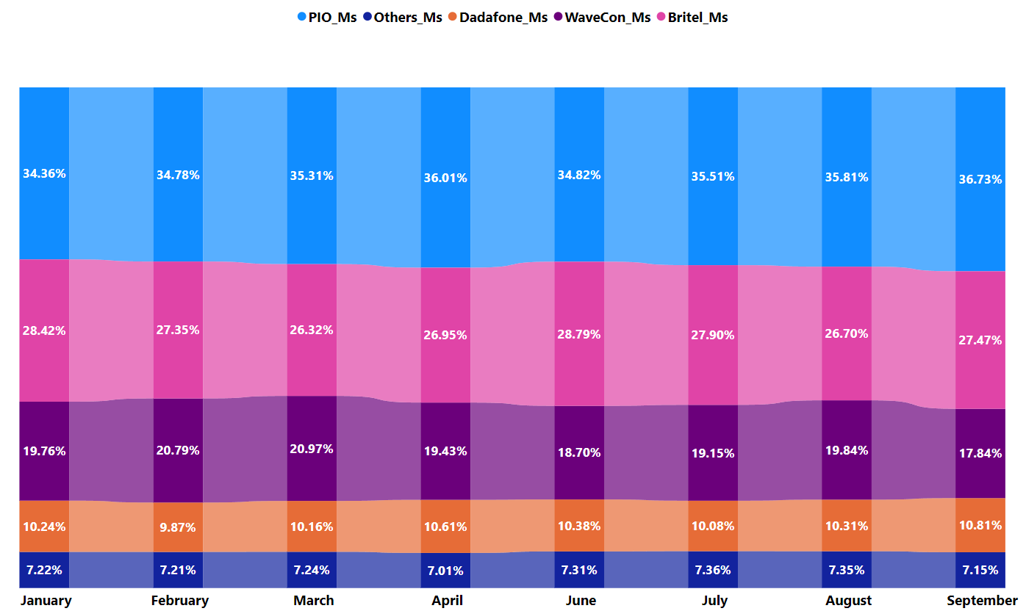
Market Domination
WaveCon's market share fluctuated over the months, reaching its peak at 20.97% in March before declining to 17.84% in September, with a slight increase observed after the introduction of 5G services in June.

Slide 11
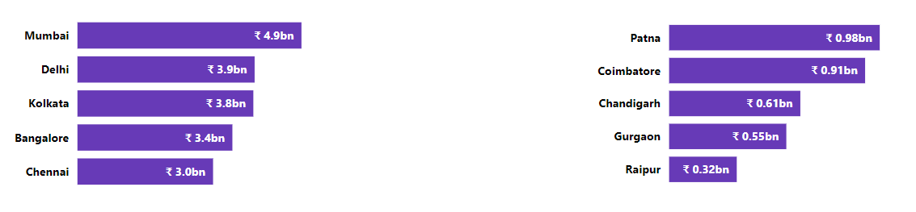
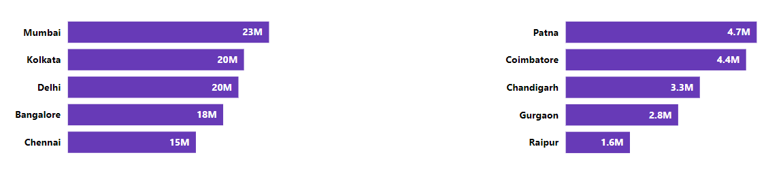
Regional Insights
Top 5 Cities
Bottom 5 Cities
Revenue
Active Users

Slide 12
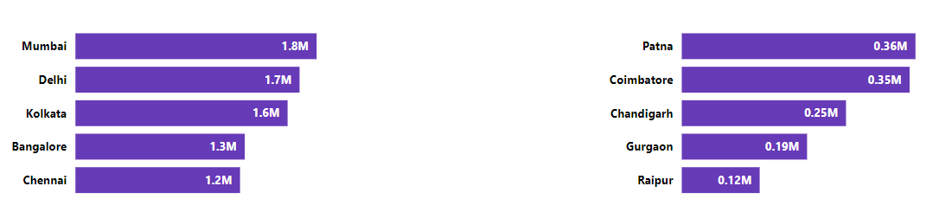
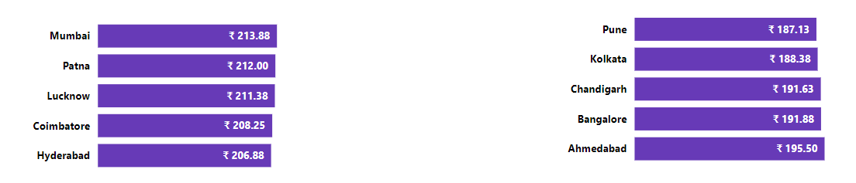
Regional Insights
Top 5 Cities
Bottom 5 Cities
Unsubscribed Users
ARPU

Slide 13
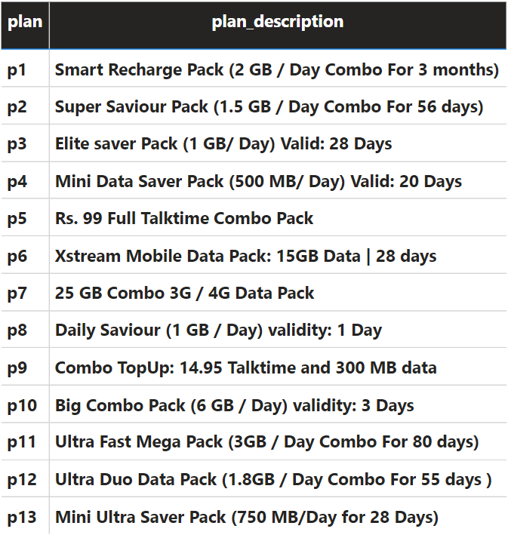
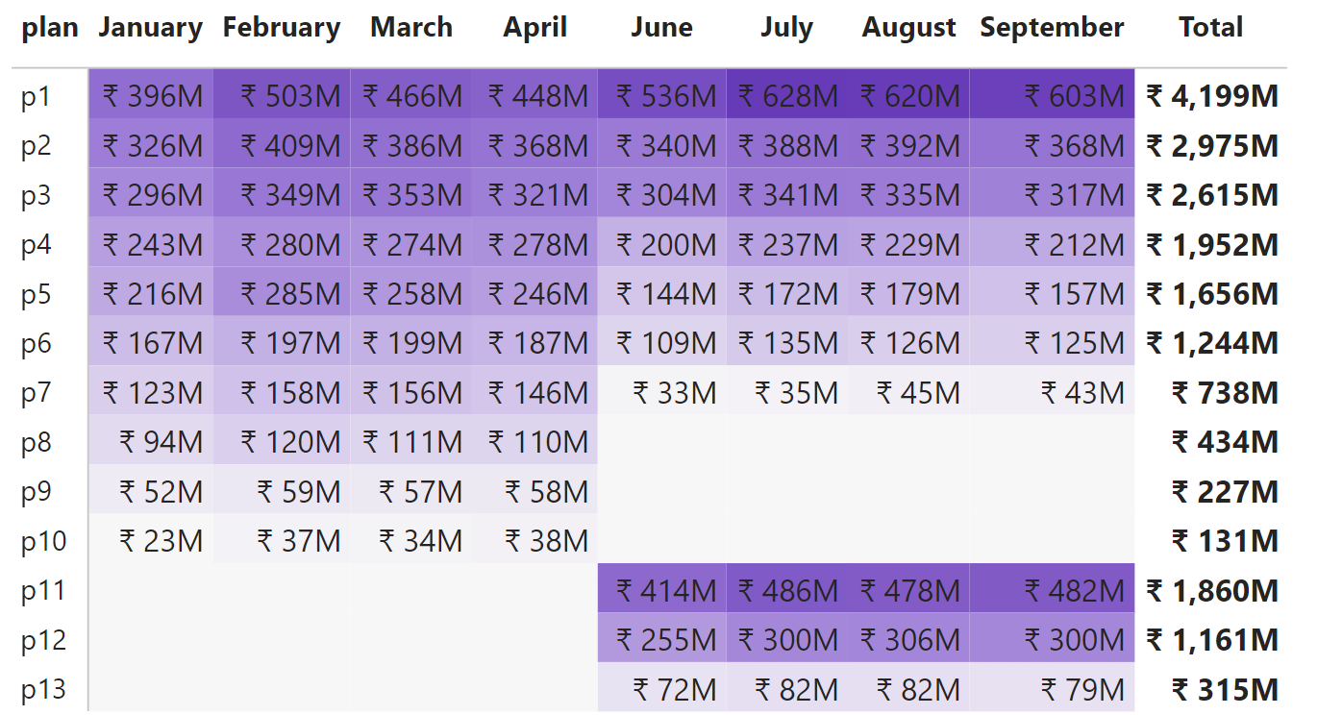
Plan Performance Review
Before the introduction of 5G, plans P8, P9, and P10 were identified as the least performing options. Post-5G launch, these plans were discontinued, making way for the introduction of new plans P11, P12, and P13.
The performance of the new plans significantly outperformed the discontinued ones, exhibiting a 4x increase in effectiveness.

Slide 14
Thank You

